Slide 1


Development of master curricula for natural disasters risk management in Western Balkan countries
Monitoring Visit to NatRisk
Project
Jelena Pandža
Academy of Criminalistic and Police Studies (KPA)
NEO Serbia Monitoring Visit / Niš, Serbia, 20 April 2017
Project number: 573806-EPP-1-2016-1-RS-EPPKA2-CBHE-JP
"This project has been funded with support from the European Commission. This publication reflects the views only of the author, and the Commission cannot be held responsible for any use which may be made of the information contained therein"

Slide 2
The KPA‘s Project Team
Development of master curricula for natural disasters risk management in Western Balkan countries
The Academy was one of the first to sign the Partnership Agreement (20 December 2016).
The initial project team consisted of experts whose references contributed to the final adoption of the project application. This project team was later enriched and now counts 19 researchers and 9 technical and administrative staff. The project team communicates and coordinates activities at meetings (3 held so far) and through e-mails.

Slide 3
What have we done so far:
Development of master curricula for natural disasters risk management in Western Balkan countries
WP 8 (Project Management), A 8.1 – Kick-off meeting – Mr Saša Mijalković, PhD (KPA’s project team leader), Mr Dane Subošić, PhD, and myself participated in the meeting held on 15 and 16 December 2016 in Niš, Serbia. We left overwhelmed with the information, but...
WP 1 (Analysis of natural disasters needed to be managed in Western Balkan region), A 1.1 (Report on natural disasters in WB) – Mr Dragan Mlađan, PhD, contributed to the final report, he sent out letters to the Sector for Analytics, Telecommunication and Information Technologies and the Emergency Management Sector of the MoI of Serbia requiring the necessary data. UNI, UNID and KPA compiled the Report on natural disasters in Serbia. Outcome: Report on natural disasters in WB.
WP 6 (Dissemination) - for better visibility of the project, a banner was placed on the KPA’s official website, linking to the official NatRisk website.

Slide 4
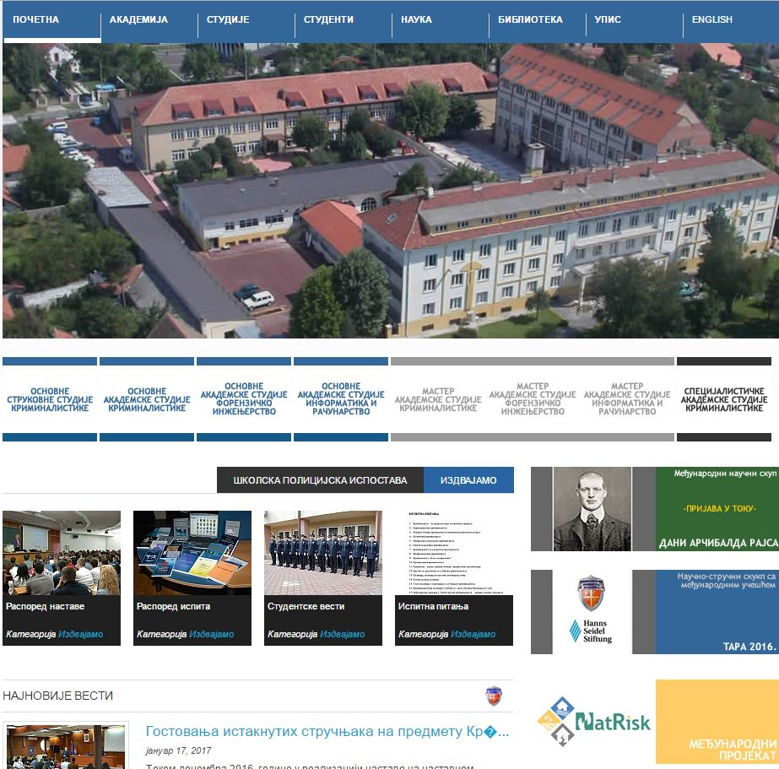
What have we done so far:
Development of master curricula for natural disasters risk management in Western Balkan countries

Slide 5
What have we done so far:
Development of master curricula for natural disasters risk management in Western Balkan countries
WP 3 (Development of trainings for citizens and public sector), A 3.1 (Survey of citizens’ and public sector awareness) – Mr Boban Milojković, PhD, distributed the questionnaires (created by UNID), collected the filled out questionnaires and delivered them to UNI. Outcome: Survey conducted (307 persons).
WP 1 (Analysis of natural disasters needed to be managed in Western Balkan region), A 1.3 (Workshop on master curricula best practices…) – A preparatory activity for the workshop was to propose a preliminary version of the new master curriculum for natural disasters risk management – our researchers designed this preliminary version and delivered it to UNI; they also developed the course content and list of teachers, taking into account the accreditation that will follow. Of course, this preliminary version will be later changed in line with the guidelines and recommendations of our EU partners.
Mr Dane Subošić, PhD, participated in the Workshop on master curricula best practices in EU partners held from 5 to 7 April 2017, at BOKU, Vienna, Austria.

Slide 6
What have we done so far:
Development of master curricula for natural disasters risk management in Western Balkan countries
WP 8 (Project Management), A 8.2 (Regular Steering Committee and Project Management meetings) – Mr Dane Subošić, PhD, participated in the First Steering committee meeting held on 5 April 2017 at BOKU, Vienna, Austria, and the First Project Management Committee meeting held on 6 April 2017 at BOKU, Vienna, Austria.
WP 5 (Quality assurance and monitoring), A 5.1 (Regular Quality Assurance Committee meetings) - Mr Dane Subošić, PhD, participated in the First Quality Assurance Committee meeting held on 7 April 2017 at BOKU, Vienna, Austria.
WP 2 (Development of master curricula), A 2.5 (Harmonization of teaching environment with EU best practices and purchasing of laboratory equipment and literature) – Ms Brankica Popović, PhD, participated in the Tender Commission for integrated purchasing of equipment and software, Tender Opening and selection of offers carried out on 18 April 2017, in Niš, Serbia. Three companies sent their offers. After tender opening, the commission selected the best offers.

Slide 7
What have we done so far:
Development of master curricula for natural disasters risk management in Western Balkan countries
WP 5 (Quality assurance and monitoring), A 5.2 (Development of the quality control plan) – the KPA’s project team contributed to the creation of the Quality Control Plan. Outcome: Quality control plan adopted.
WP 6 (Dissemination), A 6.1 (Creation of the dissemination plan for the project) - the KPA’s project team contributed to the development of the Dissemination Plan. Outcome: Dissemination Plan created.
WP 7 (Exploitation), A 7.1 (Creation of sustainability plan) – the KPA’s project team contributed to the creation of the Academic Sustainability Plan and Financial Sustainability Plan. Outcome: Academic and Financial Sustainability Plans created.
WP 8 (Project Management), A 8.3 (Development of guidelines on the project management and reporting) - the KPA’s project team contributed to the creation of the Guidelines on the project management and reporting. Outcome: Guidelines on the project management and reporting created.

Slide 8
What have we done so far:
Development of master curricula for natural disasters risk management in Western Balkan countries
Partnership Agreement signed (20 December 2016)
Contact persons for individual work packages appointed.
A separate foreign currency account opened (for the needs of the project) (21 December 2016)
Day-to-day communication and consultations with NatRisk project coordinator – University of Niš (UNI).
Regular submission of quarterly reports to the coordinator, UNI (Work Progress Report)

Slide 9
What have we done so far:
Development of master curricula for natural disasters risk management in Western Balkan countries
Two representatives were appointed for the tendering procedure (19 January 2017)
The Annex VII was signed and delivered to UNI – bank account details of the beneficiary. (24 January 2017)
The Annex IX was signed and delivered to UNI – partner request for first instalment of the first pre-financing. (14 February 2017)
A total amount of 10,906.50 EUR was transferred to the KPA’s separate foreign currency account. (March 2017)
The KPA’s Senate adopted the Decision on appointing the members of the KPA’s project team participating in the NatRisk project (17 March 2017)

Slide 10
What we plan to do next:
Development of master curricula for natural disasters risk management in Western Balkan countries
First Financial Report for the period from 15 October 2016 until 14 April 2017, deadline 30 April 2017
Purchase equipment and software for the laboratory, install the equipment and software, deadline June 2017
Appoint teachers that will participate in the teaching staff trainings aimed at educating WB teachers about innovative teaching methods, as well as improving their professional, pedagogical and methodological knowledge, which will be organized in EU partner institutions (May 2017 – OE, Hungary, July 2017 – TUC, Greece, September 2017 – UNIME, Italy, November 2017 – BOKU, Austria).

Slide 11
What we plan to do next:
Development of master curricula for natural disasters risk management in Western Balkan countries
Increase the project’s visibility and its final outcome – Master curriculum on natural disasters risk management – through the KPA’s official website, FB page and FB group, advertise master program via Infostud
Define aims, specific competencies and learning outcomes of master curriculum – deadline August 2017
Define courses content and syllabi – deadline December 2017

Slide 12
Thank you for your attention!
Development of master curricula for natural disasters risk management in Western Balkan countries

